Slide 1
Uncertainty in Sensing (and action)

Slide 2
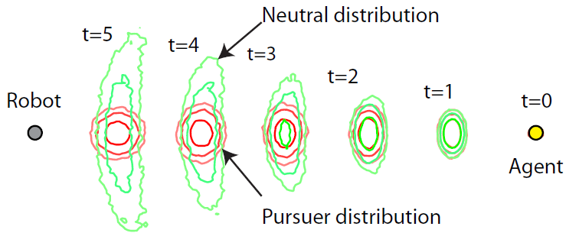
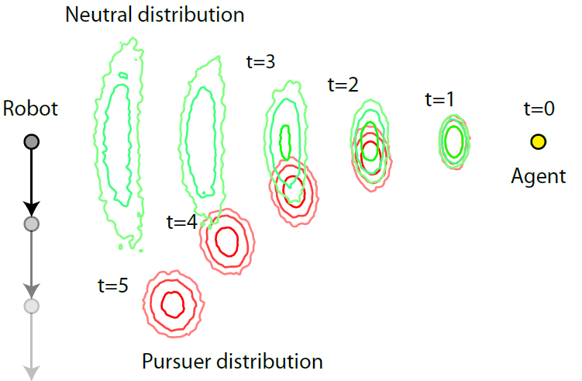
Planning With Probabilistic Uncertainty in Sensing
No motion
Perpendicular motion

Slide 3

The “Tiger” Example
Two states: s₀ (tiger-left) and s₁ (tiger right)
Observations: GL (growl-left) and GR (growl-right) received only if listen action is chosen
P(GL|s₀)=0.85, P(GR|s₀)=0.15
P(GL|s₁)=0.15, P(GL|s₁)=0.85
Rewards:
-100 if wrong door opened, +10 if correct door opened, -1 for listening

Slide 4
Belief state
Probability of s₀ vs s₁ being true underlying state
Initial belief state: P(s₀)=P(s₁)=0.5
Upon listening, the belief state should change according to the Bayesian update (filtering)
But how confident should you be on the tiger’s position before choosing a door?

Slide 5
Partially Observable MDPs
Consider the MDP model with states s∈S, actions a∈A
Reward R(s)
Transition model P(s’|s,a)
Discount factor γ
With sensing uncertainty, initial belief state is a probability distributions over state: b(s)
b(s_{i}) ≥ 0 for all s_{i}∈S, Σ_{i} b(s_{i}) = 1
Observations are generated according to a sensor model
Observation space o∈O
Sensor model P(o|s)
Resulting problem is a Partially Observable Markov Decision Process (POMDP)

Slide 6
Belief Space
Belief can be defined by a single number p_{t} = P(s₁|O₁,…,O_{t})
Optimal action does not depend on time step, just the value of p_{t}
So a policy π(p) is a map from [0,1] → {0,1,2}
0
1
p
open-left
listen
open-left
open-right

Slide 7
Utilities for non-terminal actions
Now consider π(p) → listen for p ∈ [a,b]
Reward of -1
If GR is observed at time t, p becomes
P(GR_{t}|s₁) P(s₁ | p) / P(GR_{t} | p)
0.85 p / (0.85 p + 0.15 (1-p)) = 0.85p / (0.15 + 0.7 p)
Otherwise, p becomes
P(GL_{t}|s₁) P(s₁ | p) / P(GL_{t} | p)
0.15 p / (0.15 p + 0.85 (1-p)) = 0.15p / (0.85 - 0.7 p)
So, the utility at p is
U_{π}(p) = -1 + P(GR|p) U_{π}(0.85p / (0.15 + 0.7 p)) + P(GL|p) U_{π}(0.15p / (0.85 - 0.7 p))

Slide 8
POMDP Utility Function
A policy π(b) is defined as a map from belief states to actions
Expected discounted reward with policy π: U_{π}(b) = E[Σ_{t} γ^{t} R(S_{t})] where S_{t} is the random variable indicating the state at time t
P(S₀=s) = b₀(s)
P(S₁=s) = ?

Slide 9
POMDP Utility Function
A policy π(b) is defined as a map from belief states to actions
Expected discounted reward with policy π: U_{π}(b) = E[Σ_{t} γ^{t} R(S_{t})] where S_{t} is the random variable indicating the state at time t
P(S₀=s) = b₀(s)
P(S₁=s) = P(s|π(b₀),b₀) = Σ_{s’} P(s|s’,π(b₀)) P(S₀=s’) = Σ_{s’} P(s|s’,π(b₀)) b₀(s’)

Slide 10
POMDP Utility Function
A policy π(b) is defined as a map from belief states to actions
Expected discounted reward with policy π: U_{π}(b) = E[Σ_{t} γ^{t} R(S_{t})] where S_{t} is the random variable indicating the state at time t
P(S₀=s) = b₀(s)
P(S₁=s) = Σ_{s’} P(s|s’,π(b)) b₀(s’)
P(S₂=s) = ?

Slide 11
POMDP Utility Function
A policy π(b) is defined as a map from belief states to actions
Expected discounted reward with policy π: U_{π}(b) = E[Σ_{t} γ^{t} R(S_{t})] where S_{t} is the random variable indicating the state at time t
P(S₀=s) = b₀(s)
P(S₁=s) = Σ_{s’} P(s|s’,π(b)) b₀(s’)
What belief states could the robot take on after 1 step?

Slide 12
b₀
Choose action π(b₀)
b₁
Predict
b₁(s)=Σ_{s’} P(s|s’,π(b₀)) b₀(s’)

Slide 13
b₀
Choose action π(b₀)
b₁
Predict
b₁(s)=Σ_{s’} P(s|s’,π(b₀)) b₀(s’)
Receive observation
o_{A}
o_{B}
o_{C}
o_{D}

Slide 14
b₀
Choose action π(b₀)
b₁
Predict
b₁(s)=Σ_{s’} P(s|s’,π(b₀)) b₀(s’)
Receive observation
P(o_{A}|b₁)
P(o_{B}|b₁)
P(o_{C}|b₁)
P(o_{D}|b₁)
b_{1,A}
b_{1,B}
b_{1,C}
b_{1,D}

Slide 15
b₀
Choose action π(b₀)
b₁
Predict
b₁(s)=Σ_{s’} P(s|s’,π(b₀)) b₀(s’)
Receive observation
P(o_{A}|b₁)
P(o_{B}|b₁)
P(o_{C}|b₁)
P(o_{D}|b₁)
Update belief
b_{1,A}
b_{1,B}
b_{1,C}
b_{1,D}
b_{1,A}(s) = P(s|b₁,o_{A})
b_{1,C}(s) = P(s|b₁,o_{C})
b_{1,B}(s) = P(s|b₁,o_{B})
b_{1,D}(s) = P(s|b₁,o_{D})

Slide 16
b₀
Choose action π(b₀)
b₁
Predict
b₁(s)=Σ_{s’} P(s|s’,π(b₀)) b₀(s’)
P(o|b) = Σ_{s}P(o|s)b(s)
Receive observation
P(o_{A}|b₁)
P(o_{B}|b₁)
P(o_{C}|b₁)
P(o_{D}|b₁)
Update belief
b_{1,A}
b_{1,B}
b_{1,C}
b_{1,D}
b_{1,A}(s) = P(s|b₁,o_{A})
b_{1,C}(s) = P(s|b₁,o_{C})
P(s|b,o) = P(o|s)P(s|b)/P(o|b) = 1/Z P(o|s) b(s)
b_{1,B}(s) = P(s|b₁,o_{B})
b_{1,D}(s) = P(s|b₁,o_{D})

Slide 17
Belief-space search tree
Each belief node has |A| action node successors
Each action node has |O| belief successors
Each (action,observation) pair (a,o) requires predict/update step similar to HMMs
Matrix/vector formulation:
b(s): a vector b of length |S|
P(s’|s,a): a set of |S|x|S| matrices T_{a}
P(o_{k}|s): a vector o_{k} of length |S|
b_{a} = T_{a}b (predict)
P(o_{k}|b_{a}) = o_{k}^{T} b_{a} (probability of observation)
b_{a,k} = diag(o_{k}) b_{a} / (o_{k}^{T} b_{a}) (update)
Denote this operation as b_{a,o}

Slide 18
Receding horizon search
Expand belief-space search tree to some depth h
Use an evaluation function on leaf beliefs to estimate utilities
For internal nodes, back up estimated utilities: U(b) = E[R(s)|b] + γ max_{a∈A} Σ_{o∈O} P(o|b_{a})U(b_{a,o})

Slide 19
QMDP Evaluation Function
One possible evaluation function is to compute the expectation of the underlying MDP value function over the leaf belief states
f(b) = Σ_{s} U_{MDP}(s) b(s)
“Averaging over clairvoyance”
Assumes the problem becomes instantly fully observable after 1 action
Is optimistic: U(b) ≤ f(b)
Approaches POMDP value function as state and sensing uncertainty decreases
In extreme h=1 case, this is called the QMDP policy

Slide 20
QMDP Policy (Littman, Cassandra, Kaelbling 1995)

Slide 21
Utilities for terminal actions
Consider a belief-space interval mapped to a terminating action π(p) → open-right for p ∈ [a,b]
If true state is s₁, reward is +10, otherwise -100
P(s₁)=p, so U_{π}(p) = p*10 - (1-p)*100
U_{π}
0
1
p
open-right

Slide 22
Utilities for terminal actions
Now consider π(p) → open-right for p ∈ [a,b]
If true state is s₁, reward is -100, otherwise +10
P(s₁)=p, so U_{π}(p) = -p*100 + (1-p)*10
U_{π}
0
1
p
open-left
open-right

Slide 23
Piecewise Linear Value Function
U_{π}(p) = -1 + P(GR|p) U_{π}(0.85p / P(GR | p)) + P(GL|p) U_{π}(0.15p / P(GL | p))
If we assume U_{π} at 0.85p / P(GR | p) and 0.15p / P(GL | p) are linear functions U_{π}(x) = m₁x+b₁ and U_{π}(x) = m₂x+b₂, then
U_{π}(p) = -1 + P(GR|p) (m₁ 0.85p / P(GR | p) + b₁) + P(GL|p) (m₂ 0.15p / P(GL | p) + b₂) = -1 + m₁ 0.85p + b₁ P(GR|p) + m₂ 0.15p + b₂ P(GL|p) = -1 + 0.15b₁+0.85b₂ + (m₁ 0.85 + m₂ 0.15 + 0.7 b₁ - 0.7 b₂ ) p Linear!

Slide 24
Value Iteration for POMDPs
Start with optimal zero-step rewards
Compute optimal one-step rewards given piecewise linear U
U_{π}
0
1
p
open-left
listen
open-right

Slide 25
Value Iteration for POMDPs
Start with optimal zero-step rewards
Compute optimal one-step rewards given piecewise linear U
U_{π}
0
1
p
open-left
listen
open-right

Slide 26
Value Iteration for POMDPs
Start with optimal zero-step rewards
Compute optimal one-step rewards given piecewise linear U
Repeat…
U_{π}
0
1
p
open-left
listen
open-right

Slide 27
Worst-case Complexity
Infinite-horizon undiscounted POMDPs are undecideable (reduction to halting problem)
Exact solution to infinite-horizon discounted POMDPs are intractable even for low |S|
Finite horizon: O(|S|² |A|^{h} |O|^{h})
Receding horizon approximation: one-step regret is O(γ^{h})
Approximate solution: becoming tractable for |S| in millions
α-vector point-based techniques
Monte Carlo tree search
…Beyond scope of course…

Slide 28
(Sometimes) Effective Heuristics
Assume most likely state
Works well if uncertainty is low, sensing is passive, and there are no “cliffs”
QMDP – average utilities of actions over current belief state
Works well if the agent doesn’t need to “go out of the way” to perform sensing actions
Most-likely-observation assumption
Information-gathering rewards / uncertainty penalties
Map building

Slide 29
Schedule
11/27: Robotics
11/29 Guest lecture: David Crandall, computer vision
12/4: Review
12/6: Final project presentations, review

Slide 30
Final Discussion

